Slide 1
Pitch Deck
Ingoude Company
AI‑Powered Workflow Automation Platform
MorgaN MAXWELL
2026

Slide 2
The Problem
Ingoude Company
Organizations rely on scattered tools and manual processes that slow decisions, create inconsistent customer experiences, and increase operating risk.
Teams re‑enter data, manage approvals by email, and struggle to surface insights quickly. Leaders need a dependable way to orchestrate workflows across departments while keeping quality high and costs predictable.
2

Slide 3
Our Solution
Ingoude Company
Unified Automation & Experience Platform
Build workflows visually and standardize best practices
Integrate with existing systems through connectors and APIs
Apply responsible AI to classify, route, and summarize work
Provide role‑based dashboards for operators and leaders
3

Slide 4



Product at a Glance
Ingoude Company
Design
Automate
Measure
Drag‑and‑drop builder for forms, rules, and steps.
AI assists with classification, extraction, and routing.
Live dashboards, audit history, and outcome tracking.
4

Slide 5
How It Works
Ingoude Company
Intake: Capture requests via web, mobile, or system events.
Action: Trigger updates, generate documents, and notify stakeholders.
1
4
Enrichment: Extract key fields, validate entries, and detect duplicates.
Review: Collect approvals with traceable comments and versions.
2
5
Routing: Assign tasks to people or services based on policies.
Insight: Monitor cycle times, queues, and outcomes in real time.
3
6
5

Slide 6

Why Now
Ingoude Company
Work is increasingly digital, yet many teams still rely on spreadsheets and email to coordinate critical processes. Recent advances in automation and language models make it practical to codify policies, reduce handoffs, and present clear next steps. A platform that is safe, configurable, and easy for non‑technical users meets this moment.
6

Slide 7
Value Proposition
Ingoude Company
For Operators
For Leaders
Fewer handoffs
Clear ownership
Consistent templates
Faster cycle times
Visibility into work in flight
Policy enforcement by design
Predictable outcomes
Lower operational risk
7

Slide 8
Differentiation
Ingoude Company
1
Configurable
3
AI with guardrails
Teams assemble workflows without long projects.
Human‑in‑the‑loop and explainable suggestions.
2
Clear visibility
4
Open by default
From request to result with full auditability.
Connects to data and services through standard APIs.
8

Slide 9



Product Roadmap
Ingoude Company
Near Term
Mid Term
Later
Improved builder ergonomics, template marketplace, and policy testing.
Domain‑specific AI skills, deeper role permissions, offline mobile tasks.
Autonomous workflow suggestions with human control and full explainability.
9

Slide 10

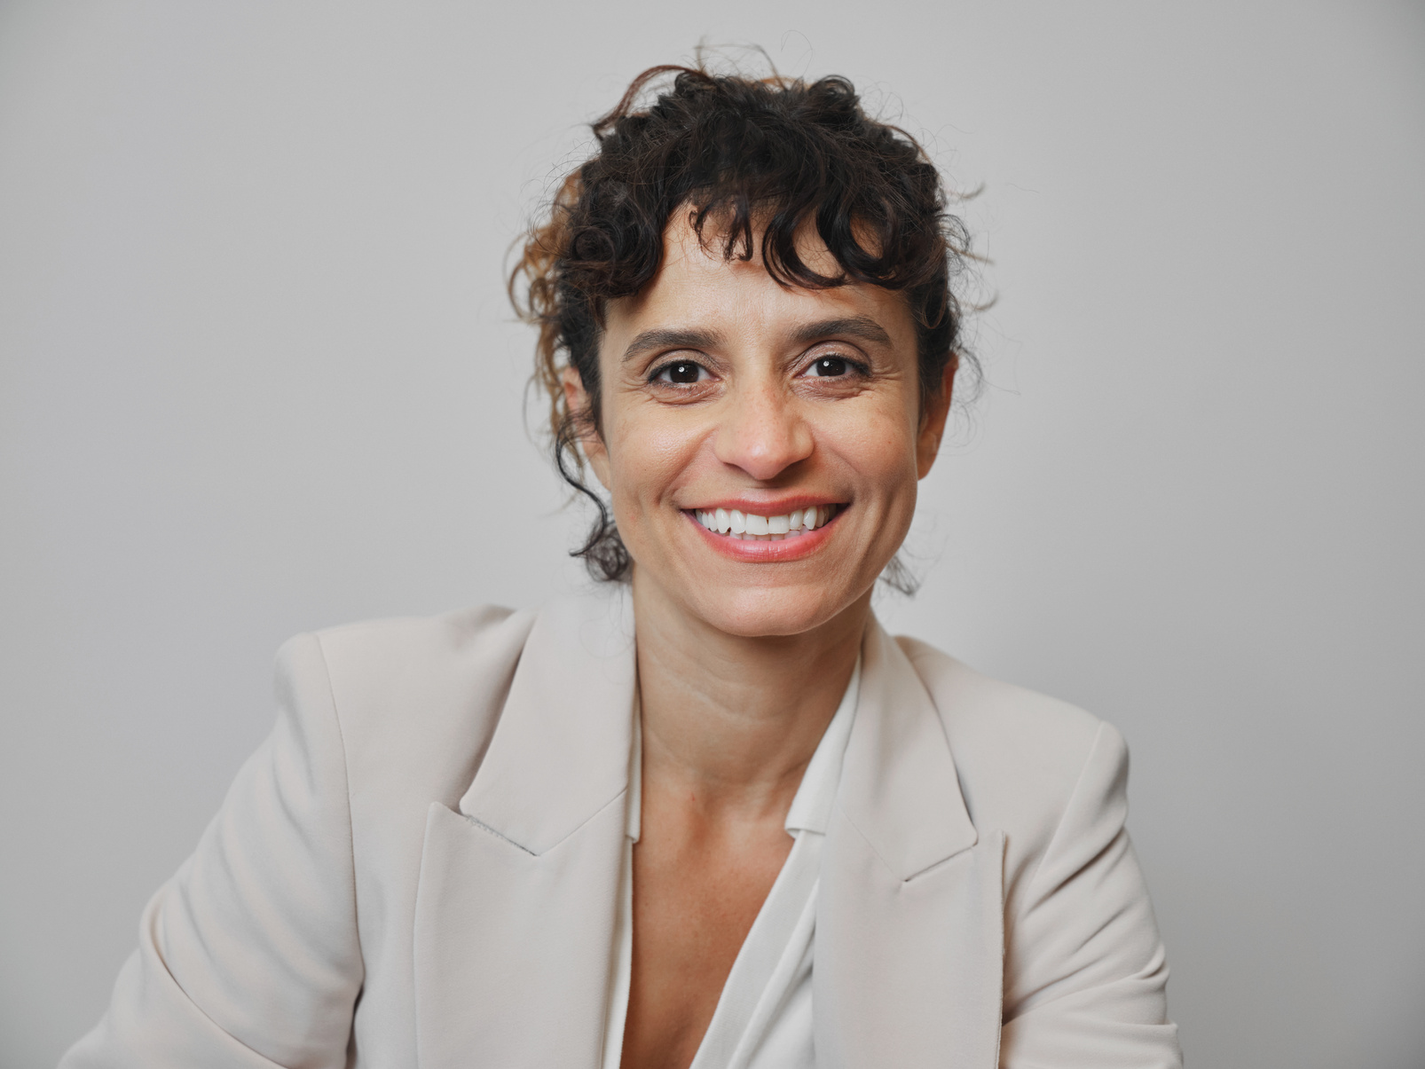


Team
Ingoude Company
Morgan Maxwell
Rachelle Beaudry
Shawn Garcia
Takehiro Kanegi
Project Manager
Project Coordinator
Project Coordinator
Project Coordinator
10

Slide 11
Ingoude Company
The End
Thank You For Listening
MorgaN MAXWELL
2026

